Slide 1
Controller-Plant model of SPMSM motor
July 2024
<Chayuth Thanakitkoses>
Intern engineering - KPIT Technologies

Slide 2
Overview
The differences between DC and AC motor
What is SPMSM
Plant Model of SPMSM
Torque control SPMSM
Speed control SPMSM

Slide 3
1. The differences between DC and PMSM

Slide 4
1. The differences between DC and PMSM
PMSM over DC motor
Less audible noise
Longer lifetime
Sparkless
Higher speed
Smaller size

Slide 5
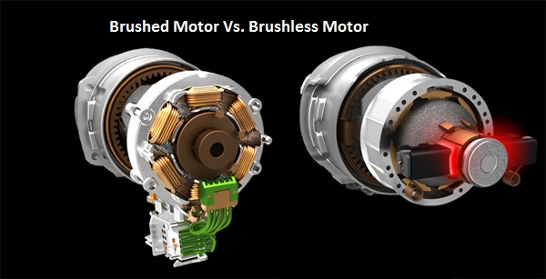
1. The differences between DC and PMSM
PMSM motor | DC motor
Constant speed | Variable speed drives
Use for high speed and variable torque | Variable speed and high torque
Can run a 3 phases supply | Single phase supply
Slow response in the change in load | Quick response to the change in load
Brushless motor | Brushed motor
Brush

Slide 6
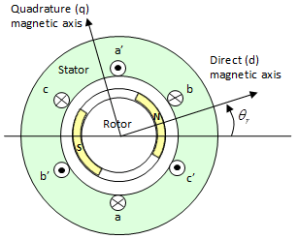
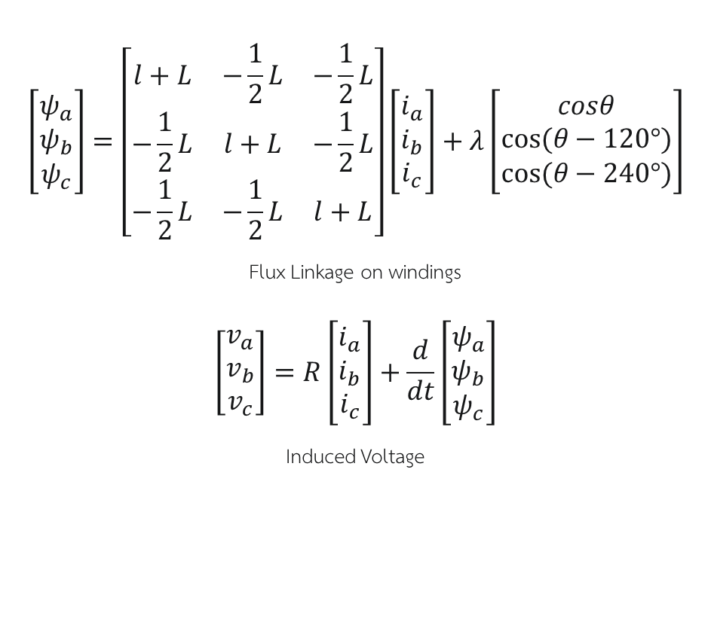
2. Surface Permanent Magnet Synchronous Motor (SPMSM)
$$\left[\begin{matrix}ψ_{a} \\ ψ_{b} \\ ψ_{c}\end{matrix}\right]=\left[\begin{matrix}l+L & −\frac{1}{2}L & −\frac{1}{2}L \\ −\frac{1}{2}L & l+L & −\frac{1}{2}L \\ −\frac{1}{2}L & −\frac{1}{2}L & l+L\end{matrix}\right]\left[\begin{matrix}i_{a} \\ i_{b} \\ i_{c}\end{matrix}\right]+λ\left[\begin{matrix}cosθ \\ cos⁡(θ−120°) \\ cos⁡(θ−240°)\end{matrix}\right]$$
Flux Linkage on windings
$$\left[\begin{matrix}v_{a} \\ v_{b} \\ v_{c}\end{matrix}\right]=R\left[\begin{matrix}i_{a} \\ i_{b} \\ i_{c}\end{matrix}\right]+\frac{d}{dt}\left[\begin{matrix}ψ_{a} \\ ψ_{b} \\ ψ_{c}\end{matrix}\right]$$
Induced Voltage
2 Poles SPMSM
“Pole is the number permanent magnetic”

Slide 7
2. Surface Permanent Magnet Synchronous Motor (SPMSM)
2 main problem in 3 Phase motor
3 Phase voltage input
Each parameters are related to the different axis

Slide 8
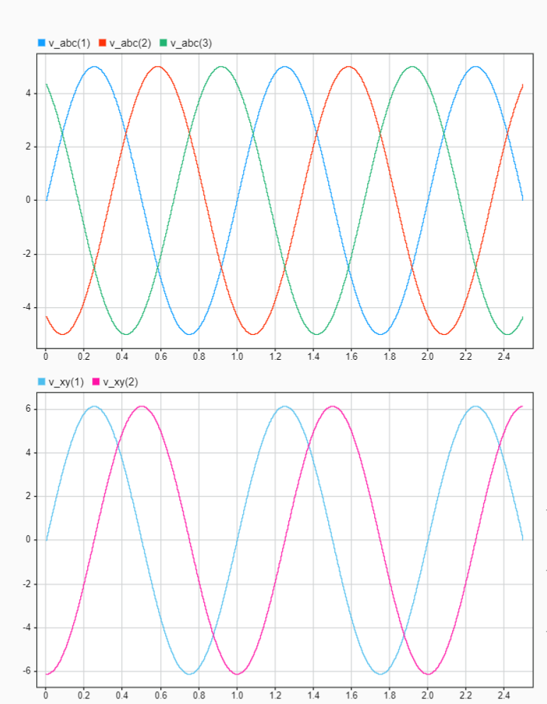
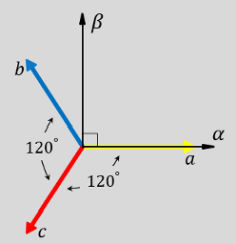
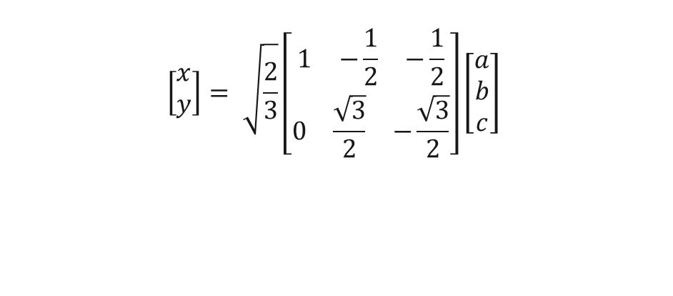
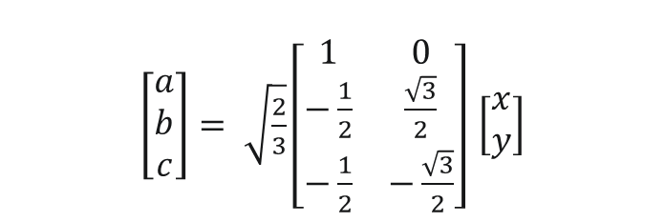

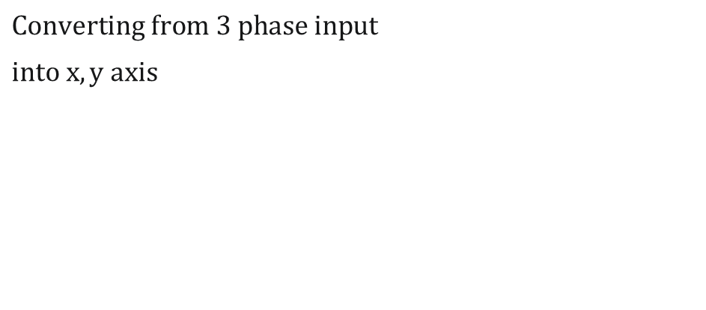
Clarke Transformation
$$Converting from 3 phase input$$
$$into x,y axis$$
y
$$\left[\begin{aligned}x \\ y\end{aligned}\right]= \sqrt{\frac{2}{3}}\left[\begin{aligned}\begin{matrix}1 & −\frac{1}{2} & −\frac{1}{2}\end{matrix} \\ \begin{matrix}0 & \frac{\sqrt{3}}{2} & −\frac{\sqrt{3}}{2}\end{matrix}\end{aligned}\right]\left[\begin{matrix}a \\ b \\ c\end{matrix}\right]$$
x
$$inverse clarke transformation$$
$\left[\begin{matrix}a \\ b \\ c\end{matrix}\right]= \sqrt{\frac{2}{3}}\left[\begin{matrix}1 & 0 \\ −\frac{1}{2} & \frac{\sqrt{3}}{2} \\ −\frac{1}{2} & −\frac{\sqrt{3}}{2}\end{matrix}\right]$ $\left[\begin{aligned}x \\ y\end{aligned}\right]$

Slide 9
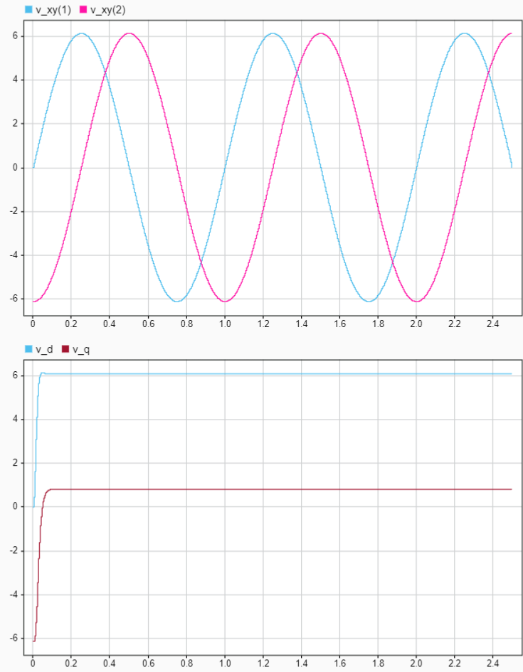
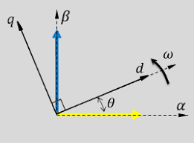
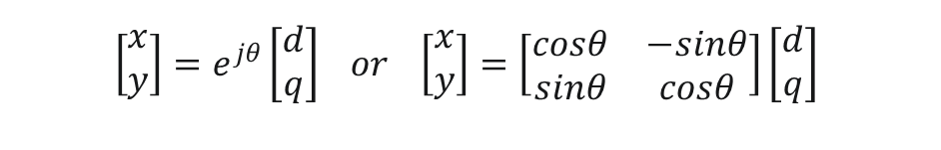

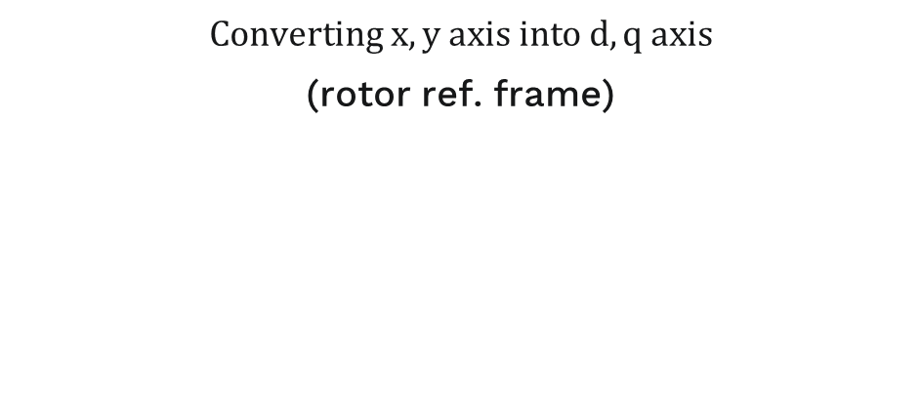
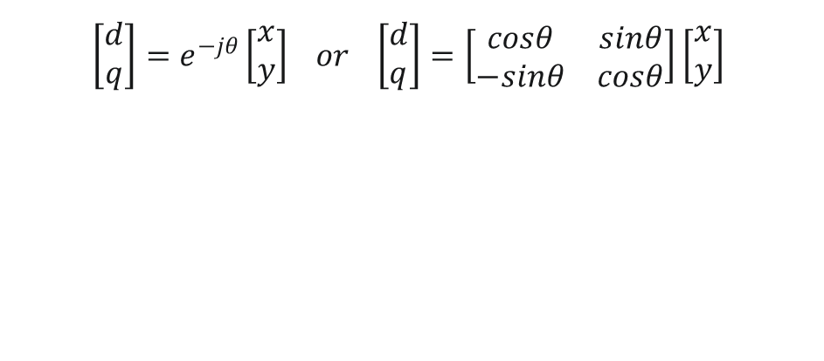
Park Transformation
$Converting x,y axis into d,q axis$
(rotor ref. frame)
y
$$\left[\begin{aligned}d \\ q\end{aligned}\right]=e^{−jθ}\left[\begin{aligned}x \\ y\end{aligned}\right] or \left[\begin{aligned}d \\ q\end{aligned}\right]=\left[\begin{matrix}cosθ & sinθ \\ −sinθ & cosθ\end{matrix}\right]\left[\begin{aligned}x \\ y\end{aligned}\right]$$
x
$$inverse park transformation$$
$$\left[\begin{aligned}x \\ y\end{aligned}\right]=e^{jθ}\left[\begin{aligned}d \\ q\end{aligned}\right] or \left[\begin{aligned}x \\ y\end{aligned}\right]=\left[\begin{matrix}cosθ & −sinθ \\ sinθ & cosθ\end{matrix}\right]\left[\begin{aligned}d \\ q\end{aligned}\right]$$

Slide 10
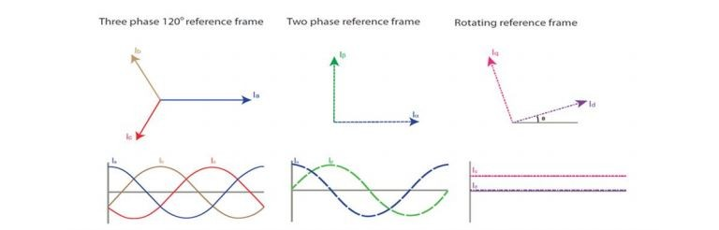
Controlled input
“2 Phase input on rotor reference frame”

Slide 11
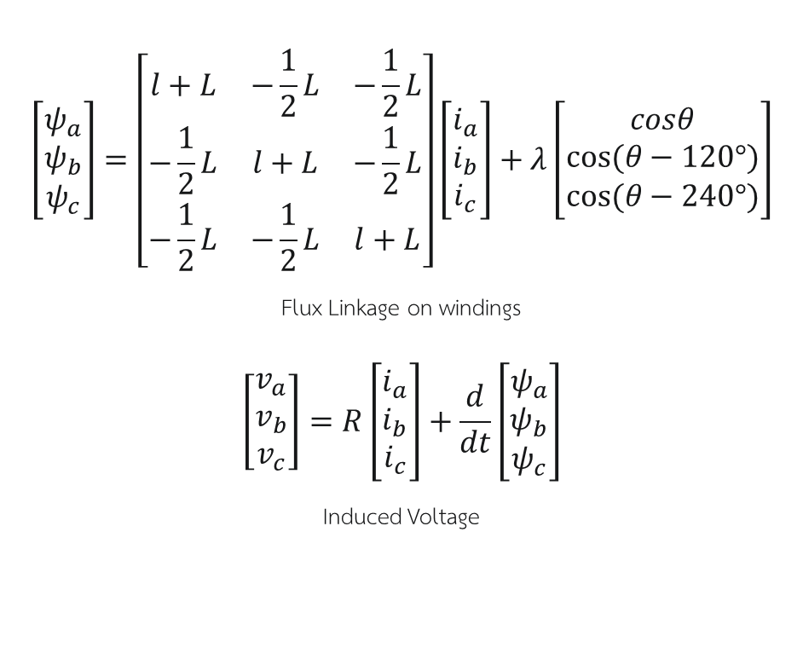

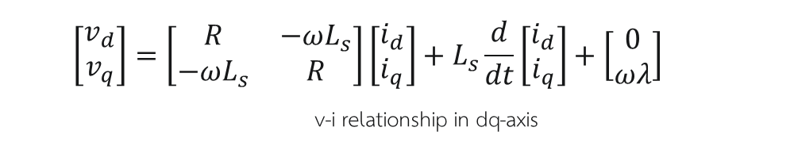


Less complicated with the dq-axis
$$3 phase (a,b,c)$$
$$2 phase (d,q)$$
$$\left[\begin{matrix}ψ_{a} \\ ψ_{b} \\ ψ_{c}\end{matrix}\right]=\left[\begin{matrix}l+L & −\frac{1}{2}L & −\frac{1}{2}L \\ −\frac{1}{2}L & l+L & −\frac{1}{2}L \\ −\frac{1}{2}L & −\frac{1}{2}L & l+L\end{matrix}\right]\left[\begin{matrix}i_{a} \\ i_{b} \\ i_{c}\end{matrix}\right]+λ\left[\begin{matrix}cosθ \\ cos⁡(θ−120°) \\ cos⁡(θ−240°)\end{matrix}\right]$$
Flux Linkage on windings
$$\left[\begin{matrix}v_{a} \\ v_{b} \\ v_{c}\end{matrix}\right]=R\left[\begin{matrix}i_{a} \\ i_{b} \\ i_{c}\end{matrix}\right]+\frac{d}{dt}\left[\begin{matrix}ψ_{a} \\ ψ_{b} \\ ψ_{c}\end{matrix}\right]$$
Induced Voltage
$$\left[\begin{matrix}v_{d} \\ v_{q}\end{matrix}\right]=\left[\begin{matrix}R & −ωL_{s} \\ −ωL_{s} & R\end{matrix}\right]\left[\begin{matrix}i_{d} \\ i_{q}\end{matrix}\right]+L_{s}\frac{d}{dt}\left[\begin{matrix}i_{d} \\ i_{q}\end{matrix}\right]+\left[\begin{matrix}0 \\ ωλ\end{matrix}\right]$$
v-i relationship in dq-axis
$$Less Complicated‼$$
$$no θ parameter$$

Slide 12

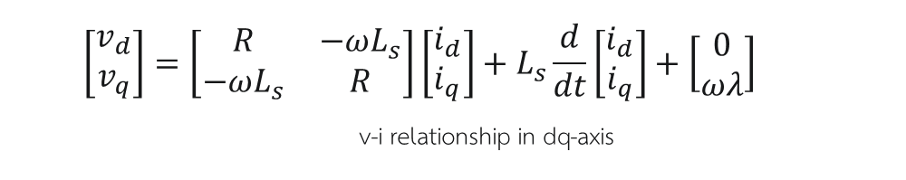

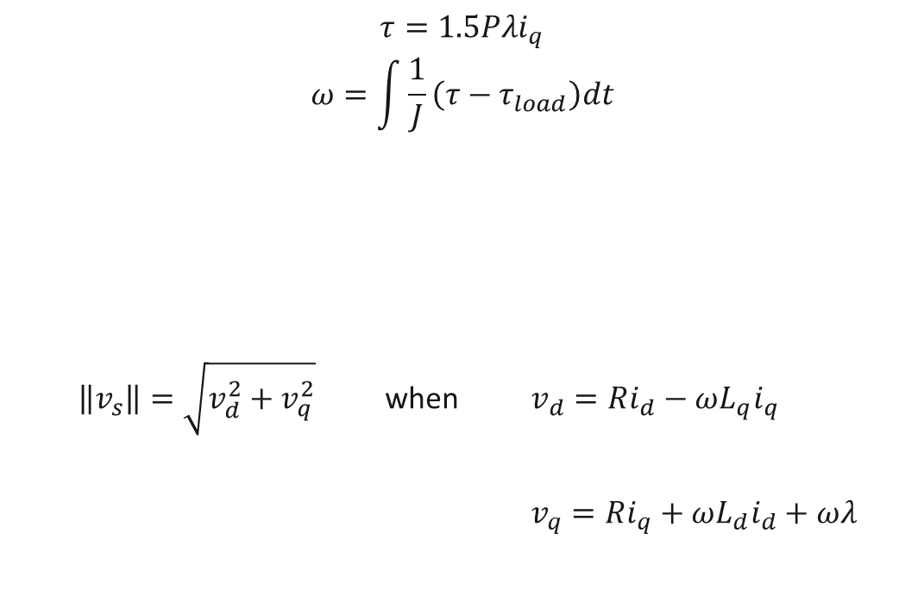
Relationship on SPMSM motor
$τ=1.5P\left[λi_{q}+\left(L_{d}−L_{q}\right)i_{d}i_{q}\right]$ when $L_{d}=L_{q}$
$$τ=1.5Pλi_{q}$$
$$ω=\int{\frac{1}{J}}\left(τ−τ_{load}\right)dt$$
$\left\|v_{s}\right\|=\sqrt{v_{d}^{2}+v_{q}^{2}}$ when $v_{d}=Ri_{d}−ωL_{q}i_{q}$
$v_{q}=Ri_{q}+ωL_{d}i_{d}+ωλ$
$$\left[\begin{matrix}v_{d} \\ v_{q}\end{matrix}\right]=\left[\begin{matrix}R & −ωL_{s} \\ −ωL_{s} & R\end{matrix}\right]\left[\begin{matrix}i_{d} \\ i_{q}\end{matrix}\right]+L_{s}\frac{d}{dt}\left[\begin{matrix}i_{d} \\ i_{q}\end{matrix}\right]+\left[\begin{matrix}0 \\ ωλ\end{matrix}\right]$$
v-i relationship in dq-axis
$(at steady state$)
$$Limitation :$$

Slide 13

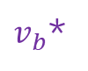
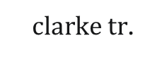

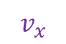

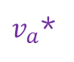
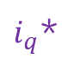
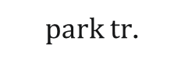
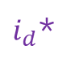
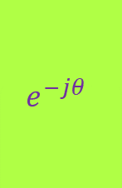

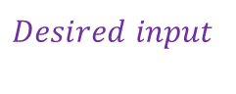

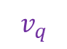

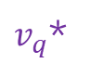

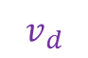
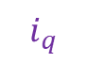

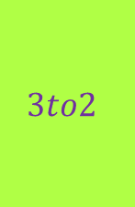
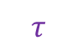
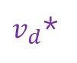
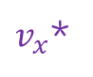
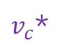
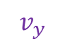
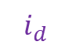

Overall idea
$$SPMSM MOTOR$$
$inverse park tr$.
$inverse clarke tr$.
$park tr$.
$clarke tr$.
$i_{d}$*
$v_{d}$*
$$e^{jθ}$$
$v_{x}$*
2to3
$v_{a}$*
$$3to2$$
$$v_{x}$$
$$e^{−jθ}$$
$$v_{d}$$
V to I
relationship
$$i_{d}$$
Mechanical
system
$$Controller$$
$v_{b}$*
$i_{q}$*
$v_{q}$*
$v_{y}$*
$$v_{y}$$
$$v_{q}$$
$$i_{q}$$
$v_{c}$*
$$Desired input$$
$$θ$$
$$θ$$
$$θ$$
$$ω$$
$$τ$$

Slide 14
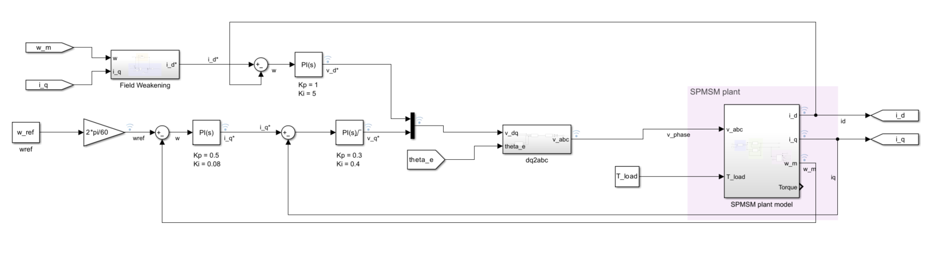
3. Plant Model of SPMSM
Input : 3 Phase voltage, T_load
Output : Torque, Speed, Position

Slide 15
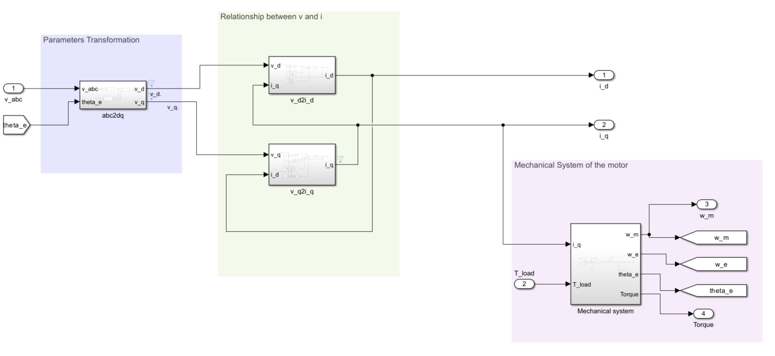
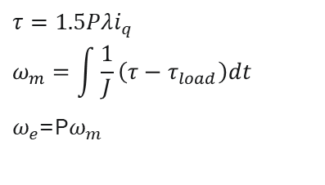

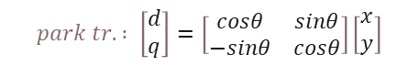
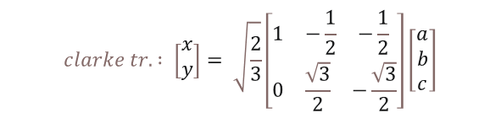
3. Plant Model of SPMSM
$$τ=1.5Pλi_{q}$$
$$ω_{m}=\int{\frac{1}{J}}\left(τ−τ_{load}\right)dt$$
$ω_{e}$=P$ω_{m}$
$$clarke tr. : \left[\begin{aligned}&x \\ &y\end{aligned}\right]= \sqrt{\frac{2}{3}}\left[\begin{aligned}&\begin{matrix}1 & −\frac{1}{2} & −\frac{1}{2}\end{matrix} \\ &\begin{matrix}0 & \frac{\sqrt{3}}{2} & −\frac{\sqrt{3}}{2}\end{matrix}\end{aligned}\right]\left[\begin{matrix}a \\ b \\ c\end{matrix}\right]$$
$$park tr. : \left[\begin{aligned}&d \\ &q\end{aligned}\right]=\left[\begin{matrix}cosθ & sinθ \\ −sinθ & cosθ\end{matrix}\right]\left[\begin{aligned}&x \\ &y\end{aligned}\right]$$
$\left[\begin{matrix}v_{d} \\ v_{q}\end{matrix}\right]=\left[\begin{matrix}R & −ωL_{s} \\ ωL_{s} & R\end{matrix}\right]\left[\begin{matrix}i_{d} \\ i_{q}\end{matrix}\right]+L_{s}\frac{d}{dt}\left[\begin{matrix}i_{d} \\ i_{q}\end{matrix}\right]+\left[\begin{matrix}0 \\ ωλ\end{matrix}\right]$
v-i relationship in dq-axis

Slide 16

4. Torque Control SPMSM
$$τ=1.5Pλi_{q}$$
$when i_{d}$ = 0

Slide 17
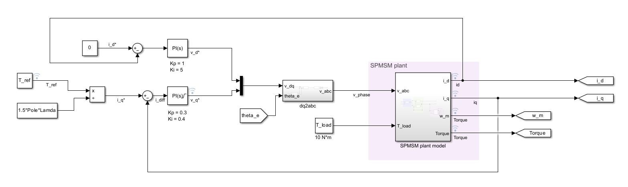



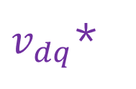
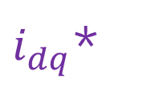
4. Torque Control SPMSM
$i_{dq}$*
$$control$$
$v_{dq}$*
$$transformation$$
$$v_{abc}$$

Slide 18

4. Torque Control SPMSM
$$control v_{d}∗,v_{q}∗$$
$$base on i_{d}∗,i_{q}∗input$$

Slide 19
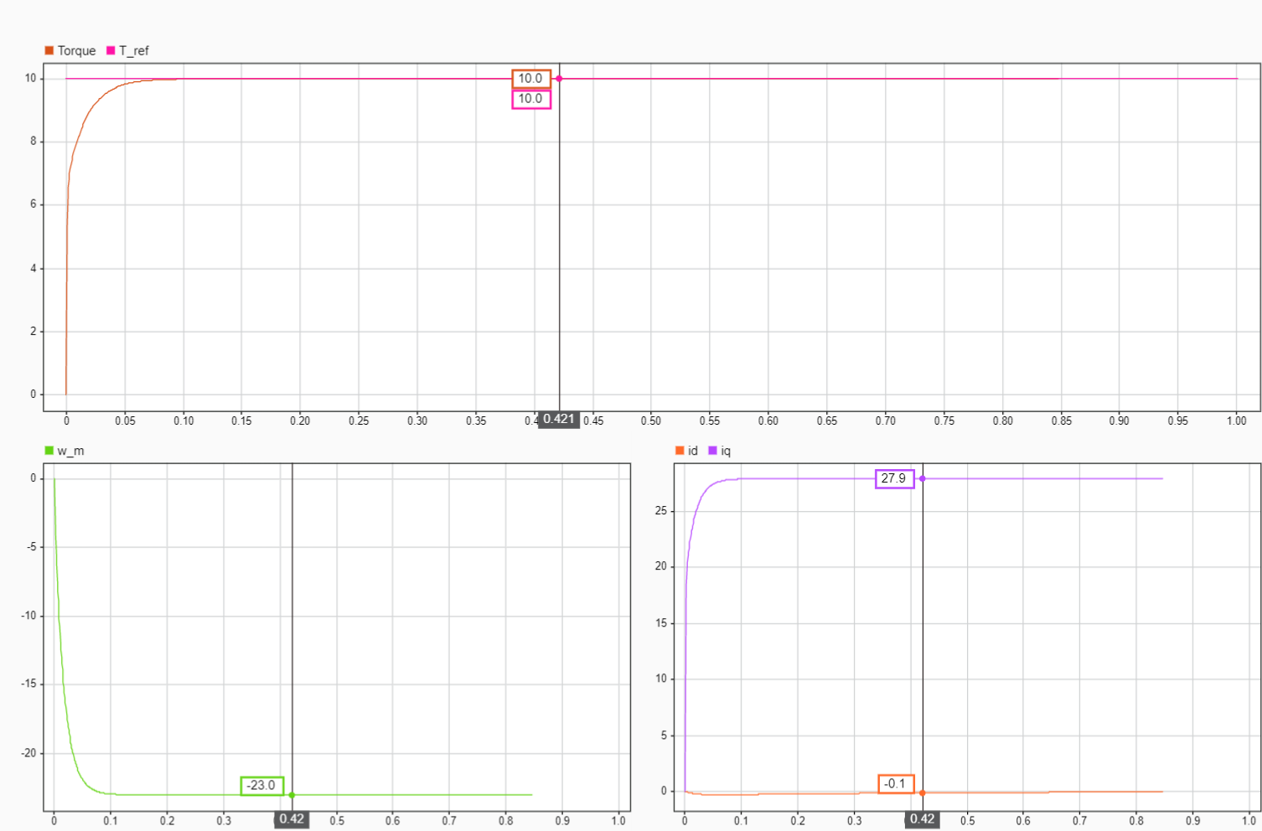
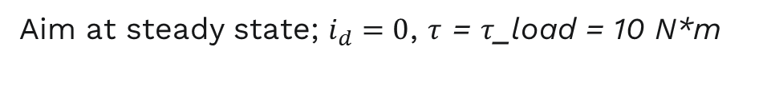
4. Torque Control SPMSM
Aim at steady state; $i_{d}=0$, $τ$ = $τ$_load = 10 N*m

Slide 20
5. Speed Control SPMSM

Slide 21

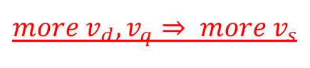


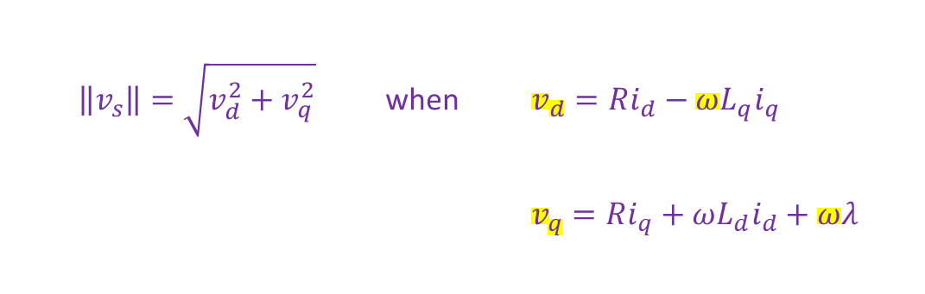
5. Speed Control SPMSM
$$τ=1.5Pλi_{q}$$
$$ω=\int{\frac{1}{J}}\left(τ−τ_{load}\right)dt$$
$if i_{d}=0$ :
We can control $ω$ from $i_{q}$
$\left\|v_{s}\right\|=\sqrt{v_{d}^{2}+v_{q}^{2}}$ when $v_{d}=Ri_{d}−ωL_{q}i_{q}$
$v_{q}=Ri_{q}+ωL_{d}i_{d}+ωλ$
$$Limitation :$$
$more v_{d},v_{q}⇒ more v_{s}$

Slide 22







5. Speed control DC motor
$\left\|v_{s}\right\|=\sqrt{v_{d}^{2}+v_{q}^{2}}$
; $\left\|v_{s}\right\|≤v_{rated}$
Limitation :
$$τ$$
$$constant torque state$$
$$\left\|v_{s}\right\|$$
$$i_{q}$$
Limitation
$$i_{d}$$
$ω_{ref}$ < $ω_{base}$
$$ω$$
0
$$ω_{base}$$

Slide 23

HOW TO INCREASE $ω$ > $ω_{base}$ ?

Slide 24


5. Speed Control SPMSM
$We need to increase ω while \left\|v_{s}\right\| stays still at the rated value$
$\left\|v_{s}\right\|=\sqrt{v_{d}^{2}+v_{q}^{2}}$ when $v_{d}=Ri_{d}−ωL_{q}i_{q}$
$v_{q}=Ri_{q}+ωL_{d}i_{d}+ωλ$
$$Limitation :$$
$i_{d}≠0 to compensate the v_{s}$

Slide 25






























Vector Analyzing
$\left\|v_{s}\right\|=\sqrt{v_{d}^{2}+v_{q}^{2}}$ when $v_{d}=Ri_{d}−ωL_{q}i_{q}$ $v_{q}=Ri_{q}+ωL_{d}i_{d}+ωλ$
$$field weakening$$
$$v_{s}>v_{rated}$$
$$constant torque$$
$$q$$
$$q$$
$ωL_{d}(+i_{d})$
$$q$$
$$R{(−i}_{d})$$
$$ωL_{q}i_{q}$$
$$ωL_{q}i_{q}$$
$$ωL_{q}i_{q}$$
$$R{(+i}_{d})$$
$ωL_{d}(−i_{d})$
$$Ri_{q}$$
$$Ri_{q}$$
$$Ri_{q}$$
$$v_{s}$$
$$v_{s}$$
$$jωλ$$
$$jωλ$$
$$jωλ$$
$$v_{s}$$
$$d$$
$$d$$
$$d$$
$i_{d}$ = 0
$i_{d}$ < 0
$i_{d}$ > 0
$$To increase ω while \left\|v_{s}\right\| is less than the rated value,$$
$$we need to increase i_{d} in a negative value (i_{d}<0)$$

Slide 26








Field Weakening
$$\left\|v_{s}\right\|=\sqrt{v_{d}^{2}+v_{q}^{2}}$$
Limitation :
$$field weakening state$$
$$τ$$
$$V_{rated}$$
$$i_{q}$$
$$τ=1.5Pλi_{q}$$
$$i_{d}$$
$$i_{d}=0$$
0
$$ω$$
$ω_{ref}$ > $ω_{base}$
$$i_{d}<0$$
$$ω_{base}$$

Slide 27









5. Speed Control SPMSM
$$τ=1.5Pλi_{q}$$
$$ω=\int{\frac{1}{J}}\left(τ−τ_{load}\right)dt$$
$$control v_{d}∗,v_{q}∗$$
$$base on i_{d}∗,i_{q}∗input$$
$ω$*
$$control$$
$i_{dq}$*
$$control$$
$v_{dq}$*
$$transformation$$
$$v_{abc}$$

Slide 28

5. Speed Control SPMSM
$$τ=1.5Pλi_{q}$$
$$ω=\int{\frac{1}{J}}\left(τ−τ_{load}\right)dt$$
$$control i_{q}∗$$
$$from the desired speed$$

Slide 29




Field Weakening control
$\left\|v_{s}\right\|=\sqrt{v_{d}^{2}+v_{q}^{2}}$ when $v_{d}=Ri_{d}−ωL_{q}i_{q}$ $v_{q}=Ri_{q}+ωL_{d}i_{d}+ωλ$
Assume that $Ri_{d}$ and $Ri_{q}≪1$
$$i_{d}= \frac{\frac{\sqrt{v_{rated}^{2}−ω^{2}L_{q}^{2}i_{q}^{2}}}{ω}−λ}{L_{d}}$$

Slide 30


5. Speed Control SPMSM
Torque Constant
Field weakening
Steady State
Speed
Vs
$$ω_{base}$$
3
1
2
3
1
2
id,iq
vd,vq
3
1
2
3
1
2

Slide 31


5.2 Speed Control with Decoupling control
$$v_{d}=Ri_{d}−ωL_{q}i_{q}$$
$$v_{q}=Ri_{q}+ωL_{d}i_{d}+ωλ$$
$v_{d}′=Ri_{d}$
$$v_{q}′=Ri_{q}$$
Control only the component which is not related to the different axis

Slide 32
5.2 Speed Control with Decoupling control
Speed Control with 3 PID controller

Slide 33


5.2 Speed Control with Decoupling control
Decoupling Control
$$v_{d}=Ri_{d}−ωL_{q}i_{q}$$
$$v_{q}=Ri_{q}+ωL_{d}i_{d}+ωλ$$

Slide 34


5.2 Speed Control with Decoupling control
Torque Constant
Field weakening
Steady State
Speed
Vs
$$ω_{base}$$
1
2
3
1
2
3
id,iq
vd,vq
1
2
3
1
2
3

Slide 35

Thank You

